Slide 1
Scientific Method

Slide 2
Understand our World
In science we are constantly attempting to understand the world around us.
In order to understand the world we need to have a goal in mind, this is where the scientific method comes in.

Slide 3
What is the Scientific Method?
The Scientific Method is a logical approach to solving problems.
There are 6 steps to the scientific method
Ask a question/See a Problem
Background Research
Construct a Hypothesis
- Hypothesis is a tentative explanation, that can be tested to determine if it is valid. “If, then statement”
Test Hypothesis
Analyze data and draw conclusion
Repeat

Slide 4
How to use Scientific Method
Step 1: Ask a question/Observe a Problem
You go to your car in the morning and when you try to crank the car it won’t start.
What is the question/problem?

Slide 5
How to use Scientific Method
Step 2: Background Research
What is the first thing you are likely to do?

Slide 6
How to use Scientific Method
Step 3: Construct a Hypothesis
After talking to your parents or the internet, you believe that the battery is dead.
What might your hypothesis be? (Must write hypothesis as an “if, then” statement)

Slide 7
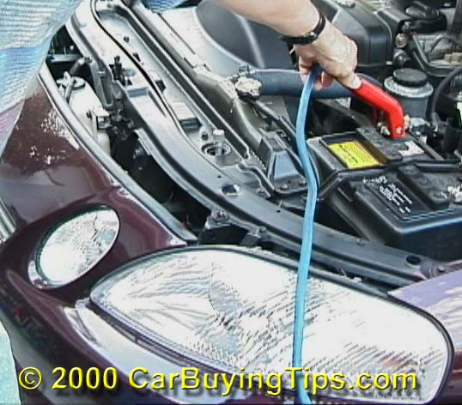
How to use Scientific Method
Step 4: Test Hypothesis
How might you test your hypothesis?

Slide 8
How to use Scientific Method
Step 5: Analyze Data
If after you replace the battery the car still won’t start then what can you deduce?

Slide 9
How to use Scientific Method
Step 6: Repeat
After your first hypothesis failed to be correct you must go back and create a new hypothesis.

Slide 11
Variables
Everything in your experiment can be labeled as a variable or a constant.
In your experiment you had two types of variables, independent and dependent.

Slide 12
Variables
The independent variable is what you manipulated
What was the independent variable in your experiment?
The dependent variable “depends” on the independent.
What was the dependent variable in the experiment?

Slide 13
Constants and Control
In your experiment things that change (Variables) and things that don’t change (Constants).
Constants are all the other factors not manipulated.
Spark Plugs, Gas, Alternator etc.
Control is a completely separate group that you compare your results against.
Think about a placebo and how it is used in medical experiments

Slide 14
Law’s and Theories
True or False, a scientific theory can one day turn into a law?
FALSE!!!!!!!!!!

Slide 15
Law’s and Theories
A law is used to predict what will happen, while a theory tries to explain phenomena.
Ex.
You drop a pencil.
The LAW of gravity states that it will fall, it does not matter why it falls
You find a fossil of a half reptile/half bird.
The THEORY of evolution tries to explain why.

Slide 16
One- Step Problems
4.5 ft = ______________ inches
267 days = ______________ hours
8 gallons = __________ L (1 gallon = 3.8 L)

Slide 17
Two Step Problems
410 g = ________ lbs (2.2 lbs = 1 kg)
7600 s = ___________ hours
2 km = ____________ ft
(1 mile = 5280 ft) (1.6 km = 1 mile)

Slide 18
Multi-step problem
3.55 years = ___________ mins

Slide 19
BONUS
65 mph = _____________ km/day
(1.6 km = 1 mile)

